Slide 1
Enhancing Cluster Cohesion: Integrating Self-Organizing Maps with K-Means Clustering for Improving Unsupervised Learning Distinctions
Ryan Park and Karthik Thyagarajan

Slide 2
Unsupervised Learning and Clustering
Unsupervised learning explores patterns in unlabeled data
Clustering segments data based on similarities among data points
Distinct clusters clarify data patterns and improve interpretability
Lowering cohesion metrics defines clusters with clearer boundaries
Our aim is to improve cluster cohesion using topological representations of the data.

Slide 3
Related Works
Angusto and Emilio implemented a SOM-KNN that performed competitively with both KNN and other models, while having decreased training times in digit recognition of car plates.
Khasanah did any analysis of SOM and K-Means independently. K-Means was shown to perform better than SOM as it forms centers around more dense areas.
Riveros et al. is a study that implemented K-Means and SOM to classify patients with spinal problems. SOM was found to perform better than K-Means in terms of classification.
Sharma implemented a support vector machine on the Optical Recognition of the Handwritten Digits Data Set with an accuracy of 96%.
Tian et al. implemented an SOM-KNN for anomaly detection and it was found to be resilient to noise and had resiliency to abnormal data.

Slide 4
Metrics and Other Info

Slide 5


Sum Squared Error (SSE) Metric
Measures cluster compactness and dispersion
Aims to minimize the sum of squared distances in clusters
Lower SSE implies data points closer to their cluster centroids
Indicates better-defined clusters with clearer boundaries
Average SSE equalizes across differently-sized datasets

Slide 6

Silhouette Score
Evaluates clustering quality and separation.
Ranges from -1 to 1, indicating cluster appropriateness.
Measures how well data points fit within their clusters.
Higher score implies well-separated and distinct clusters.

Slide 7
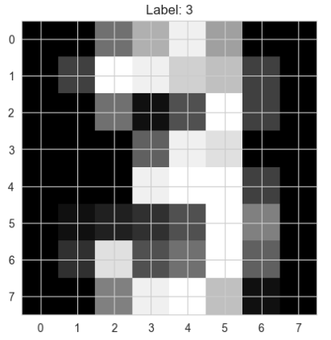
Dataset
Dataset is “optdigits” from UCI MLR
Handwritten digits on 8x8 grayscale images
64 attributes for each pixel
3823 samples, no missing values
Class labels 0-9, corresponding to digits for each data point
Preprocessing: Z-score normalization for data standardization.

Slide 8
Algorithms

Slide 9
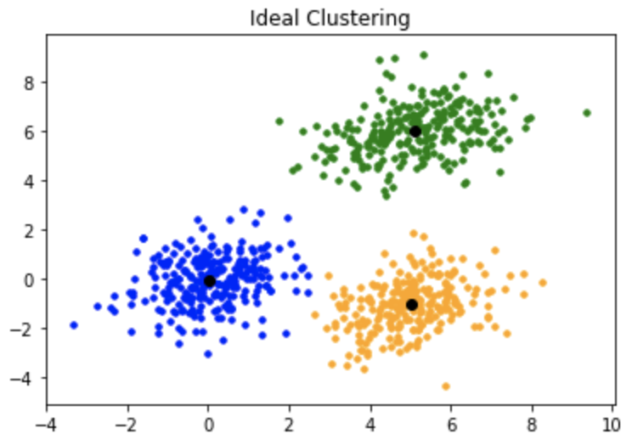
K-Means
Objective is to partition data into K clusters iteratively
Steps:
Initialize centroids randomly or strategically
Assign data points to the nearest centroid
Update centroids based on the mean of data points in clusters
Repeat until convergence or predefined iterations

Slide 10

K-Means++
Improves initialization for K-means clustering
Initialization:
Select the first centroid randomly from data points
Calculate distances and probabilities for other centroids
Choose subsequent centroids with higher probabilities
Enhances convergence speed and clustering quality
Subsequent centroids are selected from other existing points with probability:
Where D(x) is the distance to the nearest existing centroid

Slide 11
SOMs
Maps high-dimensional data onto a low-dimensional grid
Consists of a grid of nodes or neurons
Neurons compete to represent input data patterns
Topological preservation maintains spatial relationships
Training:
Find Best Matching Unit (BMU) to a random point based on distance metric
Iteratively adjusts BMU weights based on input using learning rate
Neighborhood function updates neighboring neurons
Produces a topological representation of input data
Widely used for visualization and dimensionality reduction
Effective in clustering and revealing data structures

Slide 12
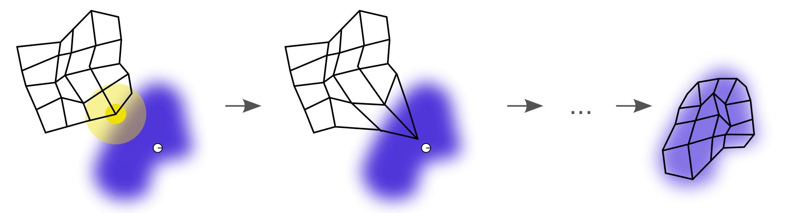
SOMs
The grid of neurons iteratively adjusts to fit the shape of the data.
Self-organizing map - Wikipedia

Slide 13
Results

Slide 14
Applying SOM to Dataset
Label Calculation for visualizations:
Determine BMU, assign datapoint label to neuron-associated list.
Use argmax from list as neuron label in SOM grid.
Empty list means unclassifiable
Not relevant to clustering
Comparative Evaluation:
K-means and K-means++ initially evaluated on dataset
Establishes benchmark for clustering performance.
Self-Organizing Maps (SOM) algorithm applied
30x30 Grid
Linearly decaying starting at 0.05 and a Manhattan distance neighborhood function decaying stepwise
Intention is to compare SOM with centroid-based approaches.

Slide 15
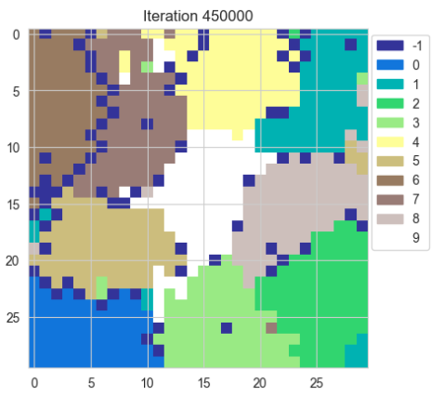
SOM Visualizations
Each of the nine digits in the dataset corresponds to a color, while -1 (dark blue) corresponds to an unclassifiable neuron.
Circular distribution suggests roughly spherical shape in higher dimensions.

Slide 16
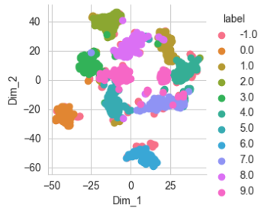
SOM Visualizations
tSNE was used to visualize 64-dimensional data in 2D.
Similar to PCA, except it can visualize nonlinear distribution boundaries.
Calculates similarities
between points and uses gradient descent and normal distributions to find the distances between similar points.

Slide 17
Performance Results
 | K-Means | K-Means++ | K-Means With SOM | K-Means++ With SOM
SSE | 2.492 x 10⁶ | 2.491 x 10⁶ | 5.691 x 10³ | 5.721 x 10³
Average SSE Per Point | 651.716 | 651.715 | 19.695 | 19.795
Silhouette Score | 0.198 | 0.198 | 0.331 | 0.279

Slide 18
Discussion
There is inherent grouping within the dataset as there are distinct boundaries around each group
K-Means algorithm with SOM had the best performance
Likely due to the closer proximity of the centers within the machine learning model facilitated by SOM, which results in denser and more compact clusters
SOM preserves variability and distinctiveness of clusters, which makes these clusters easier to identify
SOM strengthens the clusterization, while K-Means tends to find the closest center, leading to better values

Slide 19
Future Work
Integrate SOM into more machine learning models, such as neural networks
When applied with KNN, the training time was decreased significantly as a result of the model’s algorithm having to loop over every point
With more time, we would have a more concrete understanding of SOM’s effect on training times
Investigate changing the SOM size and structure (more circular rather than rectangular, more neurons, etc.)

Slide 20
Contributions
Karthik came up with the idea
Ryan coded the clustering algorithms and cohesion metrics
Karthik coded the SOM
Both wrote the paper

Slide 21
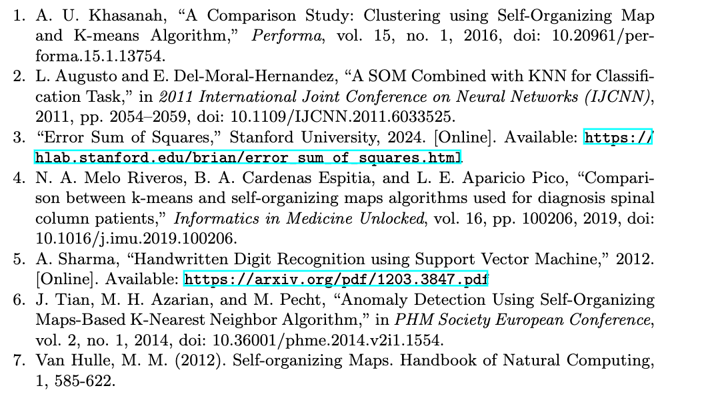
References

